Slide 1
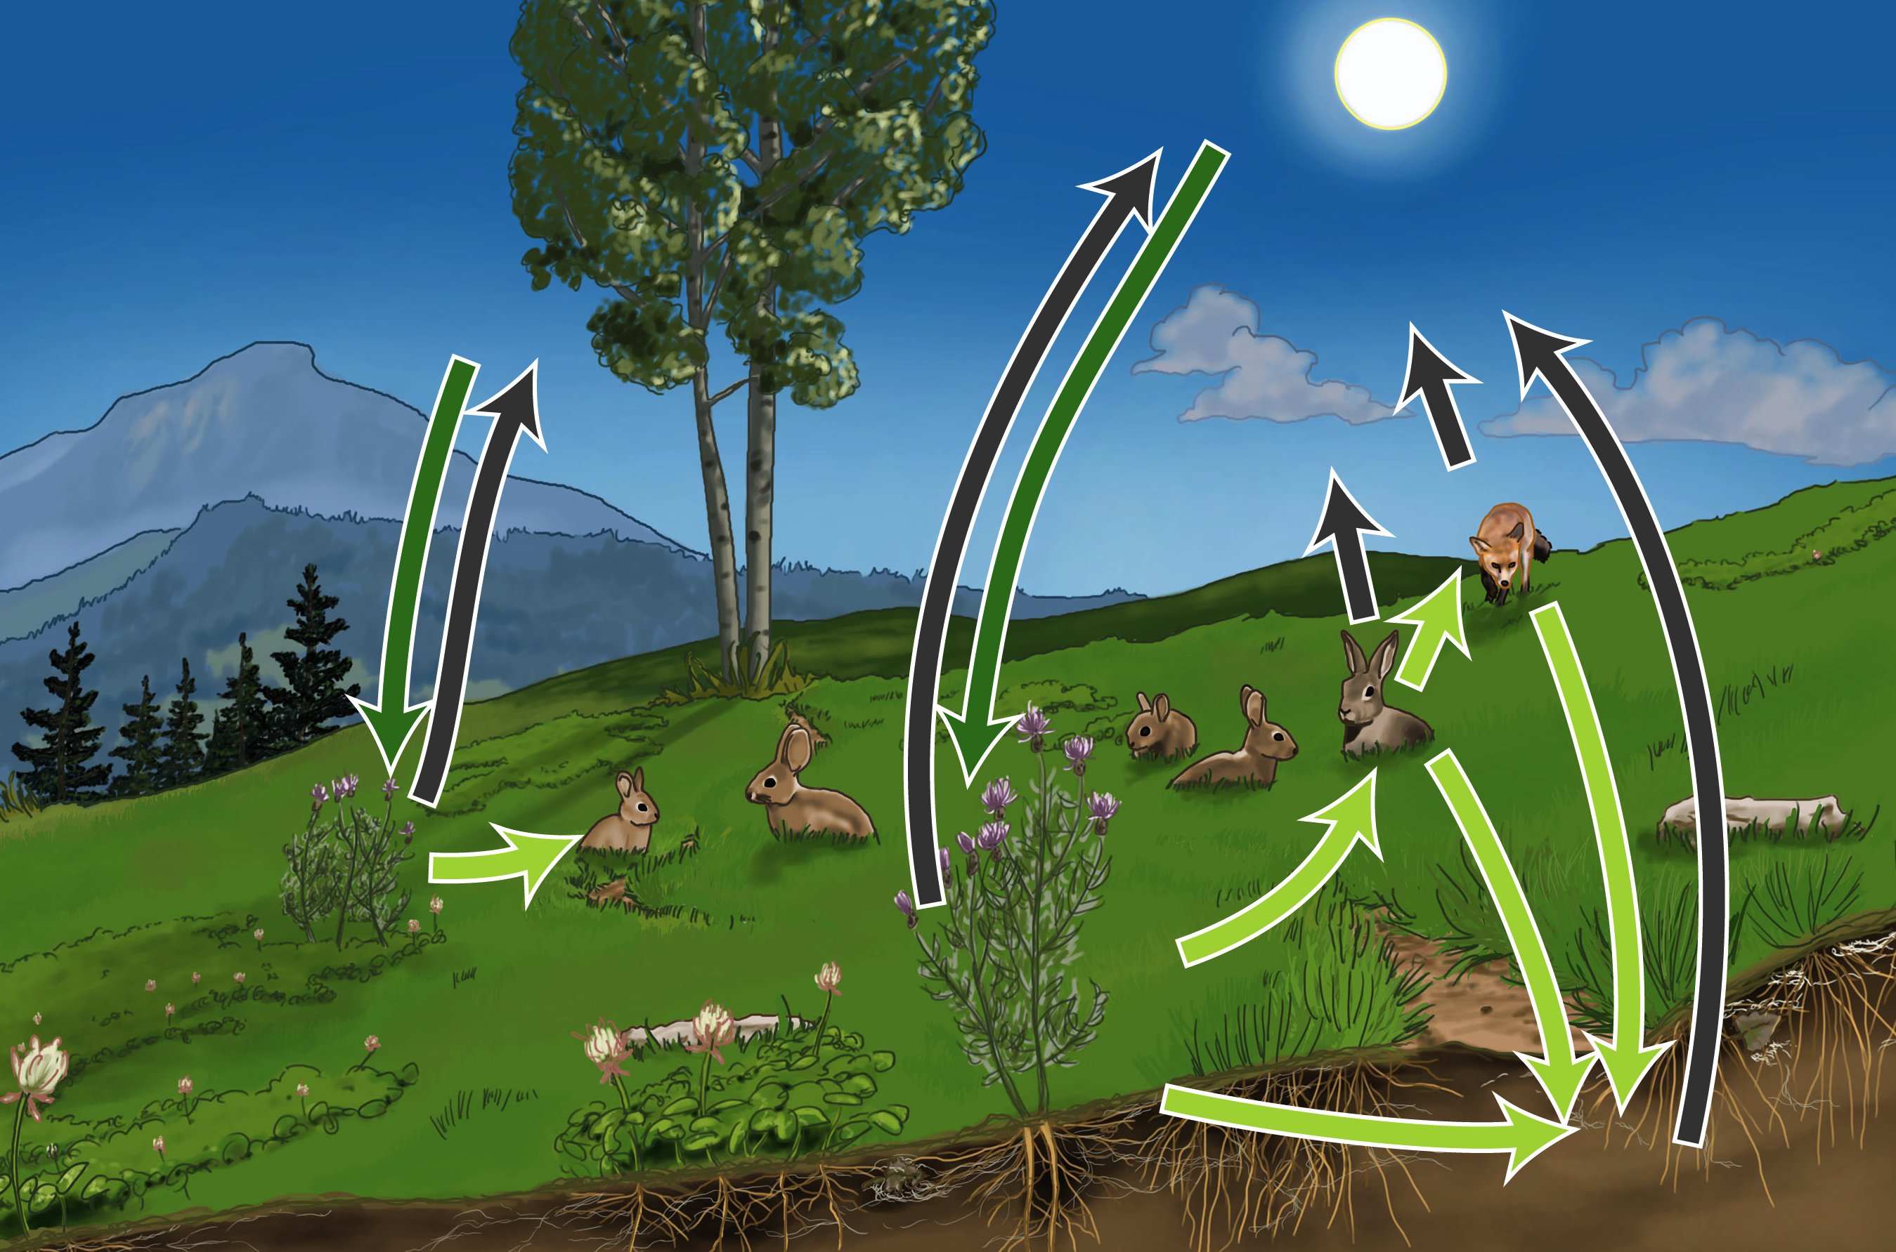
Carbon Game Discussion Questions

Slide 2
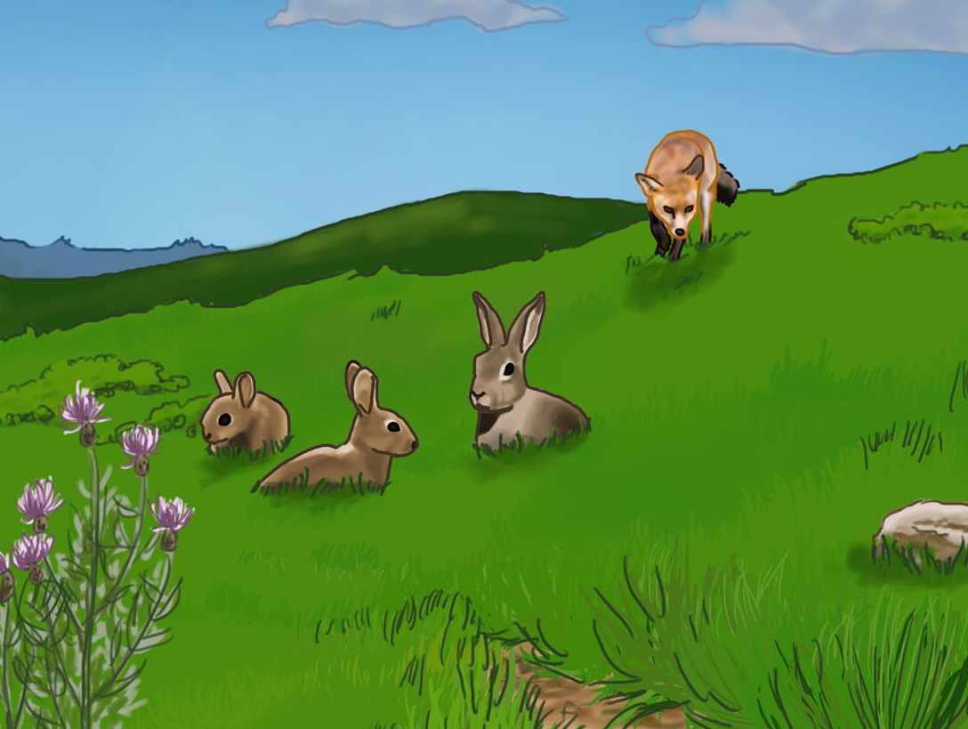
Whole Class Observations
Are there any observations about the game you would like to share?

Slide 3
Group Explanation Round #2
Now that we’ve played the game, let’s try to construct another explanation to answer this question.
How does a fox build the muscles in its leg using carbon from the air??
Step 1: A carbon atom is in the atmosphere. What happens next?
Step 2: (any suggestions?)
Step 3:
Step 4:
Step 5:
Step 6:
How does this explanation differ from our first explanation?

Slide 4
Hmmm…
Why are there no arrows in the game that go from the air to rabbits?
Why are there no arrows in the game that go from the soil to the grass?
Notes:
Because rabbits do not take up carbon from the air. They only get it from their food, which is grass.
Because producers (grass) do not take up carbon through the roots into the plant. The only way carbon can enter the plant is through photosynthesis. If this had been a game about nitrogen, phosphorous, potassium, water, or oxygen tracing, there would be arrows from the soil to the grass, because these are the things that are taken into the grass from the soil in the forms of nutrients and water.

Slide 5
Start/End Graph
Look at your worksheets to find out where you started the game.
Tell your teacher where you started the game, and where you ended the game.
Look at the graph that is generated with these data. It is called Start/End Graph.
What do you notice about the two graphs?
Notes:
Teacher Instruction: Open ChartingOurPaths.xls. Input the START and END information into the tab that says “START END Graph.”
Students may notice when they look at the graphs that the pools of carbon change in size as the game progressed.

Slide 6
Start/End Graph
Which pools got larger during the game?
Which pools got smaller during the game?
For the producer pool to get bigger, which other pools have to change size?
For the carnivore pool to get bigger, which other pools have to change size?
Notes:
Students may suggest that the carbon was taken out of the atmosphere by photosynthesis and turned into biomass in the ecosystem. In order for one station’s carbon to increase (grass, decomposer, rabbit, fox), there has to be a decrease in another pool (air).

Slide 7
Start/End Graph
If the amount of carbon stored in the biomass of ecosystems in declining, what does this tell us about the amount of carbon stored in the atmosphere?
Notes:
The carbon in the atmosphere must be rising, because the amount of carbon is stored in biomass in ecosystems is declining.

Slide 8
Visitation Graph
Divide into groups of 4 or 5.
With your group, count how many times you visited each station. (Hint: this information should be recorded on the front of your game card).
Report to your teacher the number of times your group visited the atmosphere, producers, herbivores, carnivores, and decomposers station.
Notes:
Teacher Instructions: Enter the information for each group in the BLUE squares on the Visitation Graph Tab.

Slide 9
Visitation Graph
Now look at the graph that shows how many times we visited each station.
Which pools were visited the most during the game?
Which pools were visited least during the game?
Notes:
Air, producers (ideally)
Carnivore, herbivore (ideally)

Slide 10
Visitation Graph
For a carbon atom to get from the air to the fox, which pools does it need to visit?
Can a carbon atom go from the air directly to the fox? Why or why not?
How could a carbon atom get from the rabbit to the air?
Notes:
1. It would need to visit producers (plants) then consumers (rabbits) before the fox.
2. It cannot go directly to the fox because foxes can’t photosynthesize.
3. It could either get respired right away or go to foxes then respired or go from either rabbits or foxes to decomposers.

Slide 11
Visitation Graph
Why do you think carbon visits some pools more than others?
In the game we just played, where was most of the biomass stored?
Do you think this represents where the biomass is stored in real ecosystems?
Notes:
Students may suggest that in a stable ecosystem, most of the biomass is stored in the producers and the decomposers (soil), and that you need more biomass in the producer and soil stations to support life in the rabbit and fox. It may help to remind them of the Sunny Meadows simulation, which showed that a large amount of grass was needed to support a small amount of rabbits, and an even smaller amount of foxes.
Producers.
It varies per ecosystem; but in general, most of the biomass is stored in the soil and in the producers.

Slide 12
Process Graph
Now it’s time to look at the last graph. As a carbon atom, you went through four different processes during the game that transformed you from one form of carbon to another. We call these carbon-transforming processes. In total, you went through four different carbon transforming processes. What where the four you went through?
Notes:
Photosynthesis
Digestion
Biosynthesis
Cellular Respiration

Slide 13
Process Graph
Divide into groups of 4 or 5.
With your group, count how many times you were transformed by each carbon-transforming process. (Hint: this information should be recorded on the front of your game card).
Report to your teacher the number of times your group was transformed by photosynthesis, biosynthesis, digestion, and cellular respiration.
Notes:
Teacher Instructions: Enter data from each group in the BLUE cells in the Process Graph tab. Do not worry about blank cells if you have less than 6 groups.

Slide 14
Process Graph
Look at the graph that shows the carbon-transforming processes for the entire class.
Which carbon-transforming process happened more, photosynthesis or cellular respiration?
Photosynthesis rates are higher than cellular respiration rates in a growing ecosystem. Why do you think this is?
Notes:
The graph should show that photosynthesis happens more.
When an ecosystem first begins to grow, it is important to create biomass in the producers so that the herbivores and carnivores will have food to eat. Because of this, photosynthesis happens at faster rates than cellular respiration.

Slide 15
Process Graph
Imagine that photosynthesis rates in this ecosystem increased by a lot. Based on your experience in the game, do you think this would increase or decrease the amount of biomass in this ecosystem?
Imagine that photosynthesis rates in this ecosystem increased by a lot. Based on your experience in the game, do you think this would increase or decrease the amount of respiration in this ecosystem?
Notes:
Biomass will increase if Photosynthesis rates increas, because more photosynthesis leads to more biosynthesis, which leads to more biomass.
Biomass will decrease, because less photosynthesis means that more of the carbon remains in the atmosphere and is not turned into biomass.

Slide 16
Process Graph
If the rates of photosynthesis slowed down in an ecosystem, what do you think would happen to the size of the producer, herbivore, and carnivore populations?
Notes:
There would be less biomass in the producers, which would support less herbivores, which would in turn support less foxes. The populations would all get smaller.

Slide 17
Process Graph
Organic molecules have C-C and C-H bonds. Inorganic molecules do not have C-C or C-H bonds. At which station were you an inorganic form of carbon? (Hint: there is only one)
At which stations were you an organic form of carbon?
Notes:
Air.
Producers, Herbivores, Carnivores, Decomposers

Slide 18
Process Graph
Which carbon-transforming process transformed you from inorganic form of carbon into an organic form of carbon?
Which carbon-transforming process transformed you from an organic form of carbon into an inorganic form of carbon?
At which station of the game did this happen?
Notes:
1. Photosynthesis
2. Cellular Respiration.
3. At which stations in the game did this happen? Cellular respiration happens in all the stations except the atmosphere. All organisms go through cellular respiration, even plants!

Slide 19
Material & Transformation Process Graph
According to the game, what is the only way that inorganic carbon transformed into organic biomass?
What would be the result on the planet if inorganic carbon didn’t get transformed into organic carbon?
Notes:
1. Photosynthesis
2. All living things on the planet would die. All the carbon would stay in the air and it would never get turned into plants, so all the animals would die because they wouldn’t have anything to eat. Decomposers would die because they wouldn’t have anything to eat.

Slide 20
Process Graph
Which carbon-transforming process transformed you from a small organic molecule into a LARGE organic molecule?
At which stations in the game did this process happen?
Notes:
Biosynthesis. Biosynthesis is the process of taking small organic molecules and combining them into larger organic molecules to build biomass, or the body of a plant or animal.
Biosynthesis happened in the grass, rabbit, and fox. The grass transformed glucose molecules into the cells of the grass. The rabbit transformed molecules from the grass into cells of the rabbit. And the fox transformed molecules from the rabbit into cells of the fox.

Slide 21
Process Graph
Which carbon-transforming process transformed you from a LARGE organic molecule into a small organic molecule?
At which stations in the game did this process happen?
Notes:
Digestion. Digestion is the process of breaking down larger organic molecules into smaller organic molecules. This happens in the stomach and intestines of the animals. The purpose of this is so that the molecules become small enough to be passed across membranes so that they can be carried throughout the body via the blood.
Digestion happened in the rabbit and in the fox. In the stomach of the rabbit, grass is broken down into small organic molecules. In the stomach of the fox, rabbit is broken down into small organic molecules.

Slide 22
Application
Break into groups of 4 or 5.
As a group, it is your goal to describe the path that a carbon atom takes to get from the atmosphere into the muscle of a fox. The first person in the circle should begin by describing how the carbon atom gets out of the atmosphere. Keep going until you have explained how the carbon atom gets to the muscle of a fox. This may take many times around the circle!
Notes:
Level 4 students may describe the path and be able to include how the four carbon-transforming processes contribute to the carbon’s movement and transformation through the ecosystem. Level 3 students may attempt to include processes in the path, but are likely to confuse the roles of cellular respiration and biosynthesis. Level 2 students may focus just on the movement of the atoms through the ecosystem without consideration of the processes or transformations that happen to the carbon during the path form the air to the fox.

Slide 23
Whole Group Sharing
Which group would like to share their story of how the carbon goes from the air to the muscle of the fox?

Slide 24
Was that supposed to be real?
The game you just played is a model of a real ecosystem, which means that it represents some parts of an ecosystem, but with limitations. This means what happened in the game is not exactly how things happen in a real ecosystem. With a partner, brainstorm about ways you noticed that this ecosystem is different from real ecosystems. When you are done, share your ideas with the class.

Slide 25
Here are at least 5 ways that the game differs from real ecosystems. How many of these did your class mention? Are there any ways you thought of that are not on this list?
If a rabbit or fox eats you, there is a good chance that you will not be digested. You may be passed through the digestive system and exit the body of the fox or rabbit as solid waste.
Rabbits don’t only eat grass, and foxes don’t only eat rabbits.
If you go to the decomposer station, there is a good chance that you will never be digested. You could remain there for some time as organic material that has not been digested. This is why soil is such a large carbon sink!
In rabbits and foxes, carbon atoms are sometimes biosynthesized into fat. In this case, the fat may be used in cellular respiration and the carbon atoms will return to the air after a period of time. This is not represented in the game.
It is also possible that a carbon atom in an animal is biosynthesized into a growing offspring in the mother. In this case, the carbon atom would travel from the parent to the body of the offspring.

Slide 26
Think Pair Share
Find a partner. Consider the answer to this question.
Scientists who study ecosystems are called ecologists. Ecologists have noticed that the amount of carbon stored in biomass of ecosystems is declining all over the planet. Why do you think this might be?
How do you think the following things might contribute to a decrease in stored biomass in ecosystems?
Forest Fires
Deforestation
Over-grazing
Desertification
Notes:
Answers may vary. If students mention disturbances to the ecosystem, encourage them to name specific disturbances that may affect this change. Answers may include forest fires, deforestation, loss of producers, over-grazing, desertification.

Slide 27
Application
Many ecologists are worried about increasing rates of deforestation around the planet. Based on what you saw in the game, why do you think that ecologists are worried about increasing rates of deforestation?
Notes:
If there are less producers, there is less inorganic carbon being transformed into organic carbon. This leaves more carbon in the atmosphere, which is the cause of climate change.

Slide 28
Application
Climate change is caused by an imbalance of (too much) carbon in the atmosphere. Recall that in the game, the only way for carbon to become part of organic biomass was through photosynthesis. If there were too much carbon in the atmosphere, what would be the best way to remove it?
I would increase the amount of photosynthesis on the planet.
I would decrease the amount of photosynthesis on the planet.
I would increase the amount of plants on the planet.
I would decrease the amount of plants on the planet.
Notes:
Ideal answers are (1) and (3). A decrease in photosynthesis would lead to more carbon in the atmosphere, because photosynthesis removes carbon from the atmosphere. More photosynthesis = less carbon in the air. Deforestation, desertification, over grazing, and other losses of producers all lead to decreases in photosynthesis, which in turn leave more carbon in the atmosphere.

Slide 29
Application
What are some things we do that increase the levels of carbon in the atmosphere?
What are some things we can do that decrease levels of carbon in the atmosphere?
Notes:
Answers may vary, but students may suggest that combustion (forest fires, burning of fossil fuels) could lead to an increase in carbon in the atmosphere. They might also suggest that cutting down trees, deforestation, or removal of plants might increase the amount of carbon in the atmosphere. They might also suggest that a warming planet will melt permafrost and ice, releasing carbon from these ecosystems that has been stored in frozen land and ice for a long time. These issues will be addressed more directly in the Human Energy Systems unit.
Plant producers, burn less fossil fuels, protect natural areas, etc.

Slide 30
Application
Imagine that 15 million trees were cut down in an Indonesian rain forest.
What would this do to rates of photosynthesis on the planet?
What would this do to the amount of organic biomass on the planet?
What would this do to the amount of inorganic carbon in the atmosphere?
Notes:
This would lead to a decrease in photosynthesis.
This would decrease the biomass, because the trees would be gone, and there would be less producers to take carbon from the atmosphere to make more biomass.
This would increase the amount of carbon in the atmosphere, because less producers would be taking carbon out of the atmosphere.

Slide 31
Application
Imagine that 15 million trees were planted in the Gobi Desert to stop the desert from spreading.
What would this do to the amount of photosynthesis on the planet?
What would this do to the amount of biomass on the planet?
What would this do to the amount of carbon in the atmosphere?
Notes:
This would lead to an increase in photosynthesis.
This would lead to an increase in biomass. The trees that were planted would increase the biomass, and these trees would also continue to take carbon from the atmosphere to make more biomass for the ecosystem.
This would lead to a decrease in carbon in the atmosphere, because the trees would take more carbon out of the atmosphere .

